Slide 1
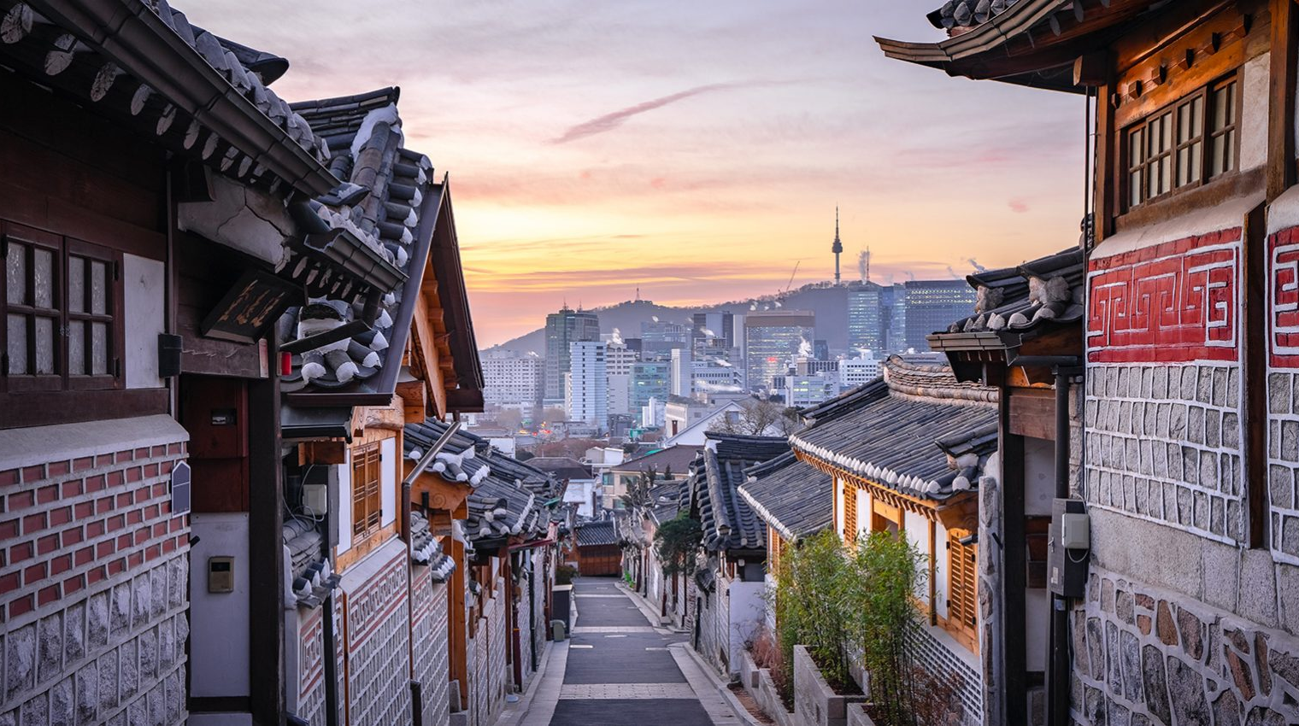
SSBSE 2025
Seoul,
Republic of Korea
16 Nov, 2025*
co-located with ASE 2025
Notes:
Hi. I am really excited to introduce SSBSE 2025 Seoul, South Korea.
I am Shin Hong, General Chair of the next year symposium.
It is my great honor to have the opportunity to bring the SSBSE community to South Korea.
It is interesting that next year symposium will be placed the very opposite point of this planet to where we are now.
This time SSBSE is co-located with ASE 2025 and this symposium will be arranged as
1-day pre- or post-conference event.
The exact date is under discussion with ASE OCs, and, tentatively speaking, it is likely to be a pre-conference, and then it’s 16 November 2025.

Slide 2
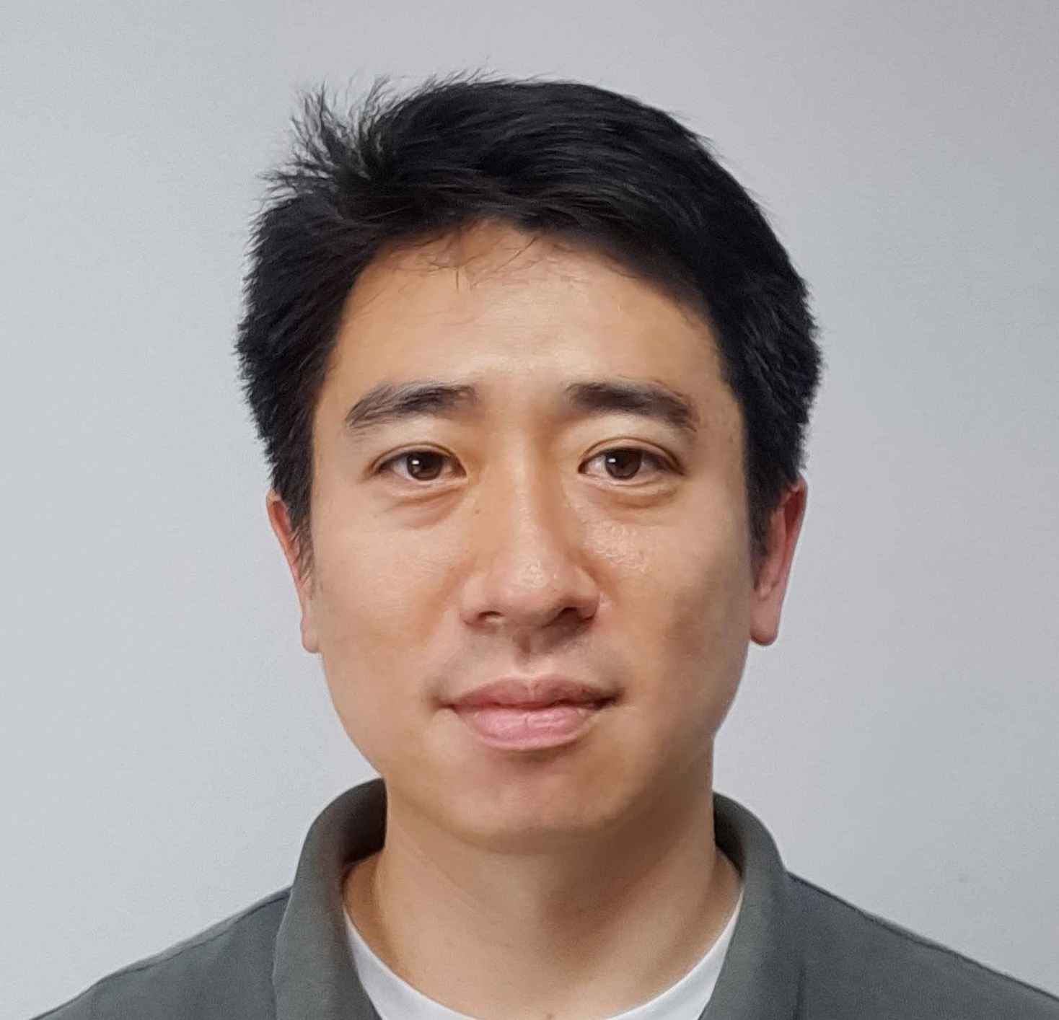
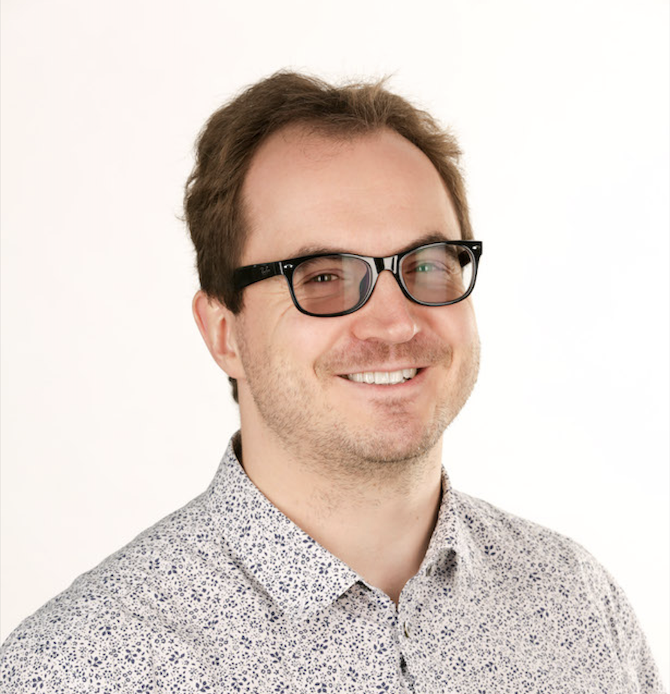
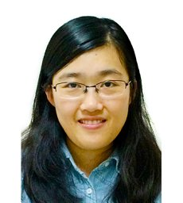
Organizing Team
Shin Hong
Associate Professor
Chungbuk National University
Republic of Korea
General Chair
Markus Wagner
Associate Professor
Monash University Australia
Program Co-Chair
Man Zhang
Professor
Beihang University
China
Program Co-Chair
Notes:
And this time, Markus Wagner from Monashi University and Man Zhang from Beihang University are serving as program co-chairs.
And we are forming the OC at this moment, inviting remaining members.
I think that some people in this room will be invited to OC, I guess.
If you receive invitation, please join in continuing this symposium successful.

Slide 3
Symposium Tracks
Research Track
RENE/NIER Track
SSBSE
Challenge Track
Hot-off-the-Press
Track
Notes:
The symposium programs will be basically the same as this year’s.
We are going to have Research Track and RENE/NIER track.
And, PC chairs and I are arranging a special issue at a major Software Engineering journal to invite quality papers.
The challenge track and Hot-off-the-press track will be continued.
Please let me know if you have new ideas to make these tracks more interesting.

Slide 4

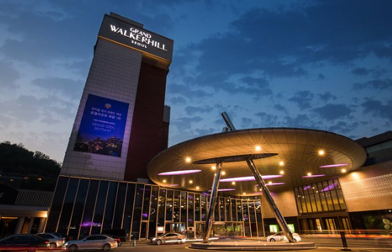
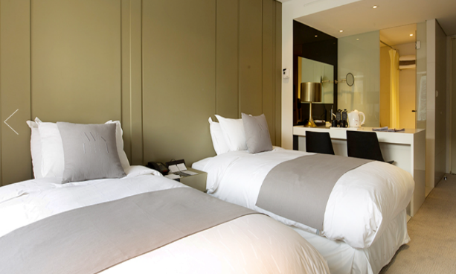

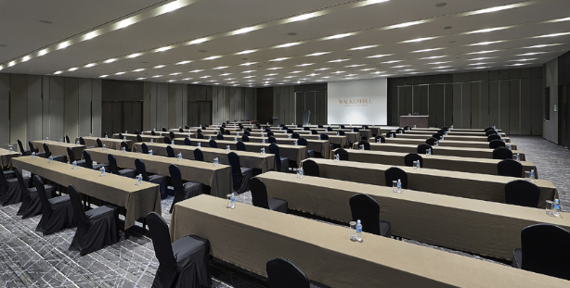
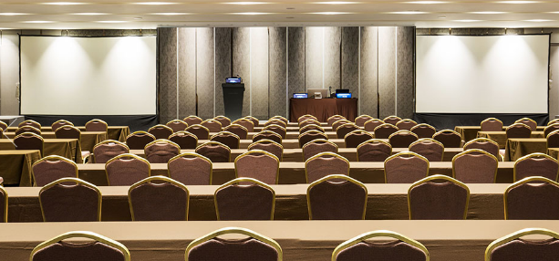
Hotel Grand Walkerhill Seoul
Unmatched Service and Value
Surrounded by the spectacular views of the Hangang River and the Achasan Mountain,
Walkerhill serves as the ultimate place to relax and unwind while enjoying a wide variety of entertainment options with unmatched quality and service.
With 557 rooms and 6 restaurants, consisting of Korean, Chinese, and Western cuisines, as well as bakery shops offering baked goodies that delight your taste buds, Walkerhill offers an unparalleled guest experience and exceeds expectation at every level.
Notes:
The venue is Hotel Grand Walkerhill Seoul, which is the one of the most elegant hotels in Seoul.
It’s not just a hotel but it’s a part of park located at North-East Side of Han-river.
This place is beloved by Seoul people, and many historic events had been held here.
Recently, many international conference had been held successfully in this hotel.

Slide 5
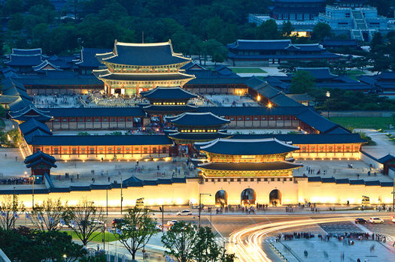
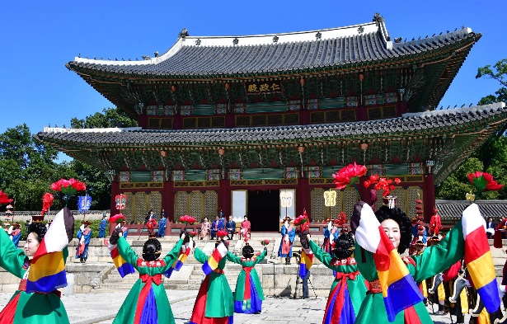
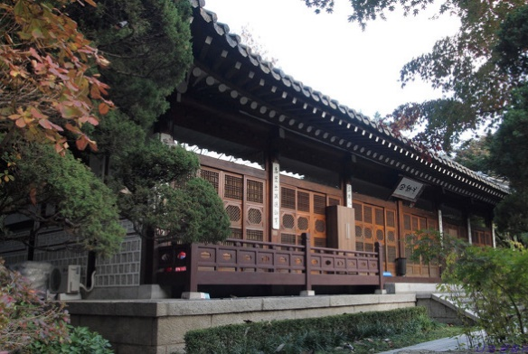
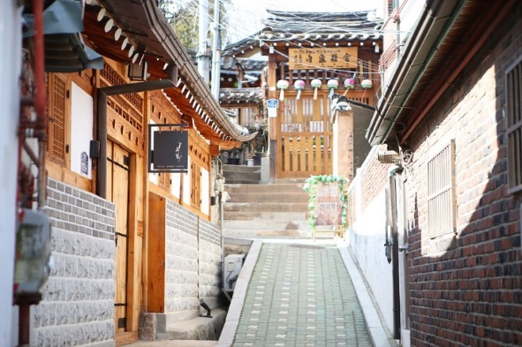
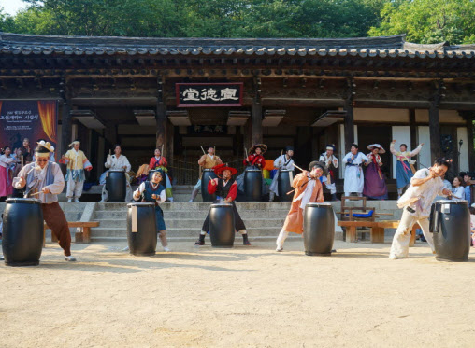
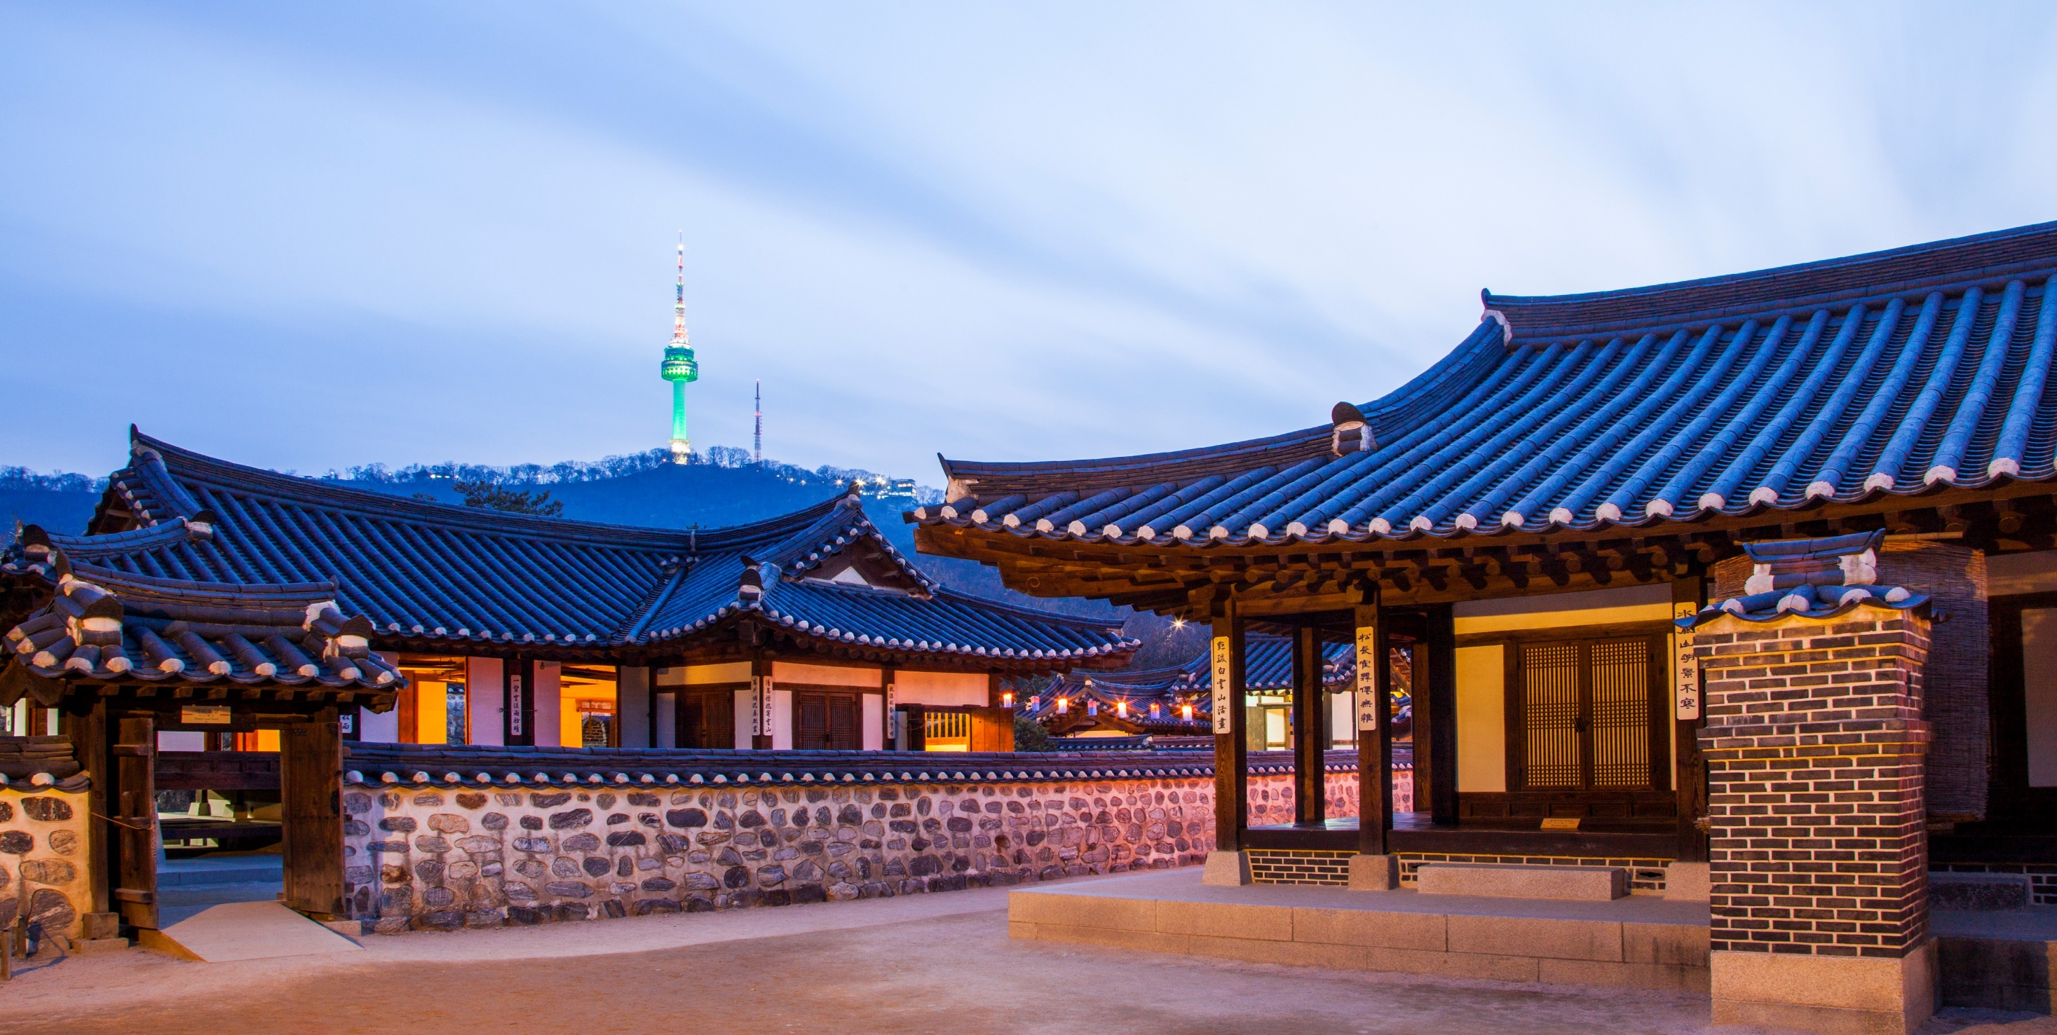
Traditions & Cultures
Gyeongbokgung
Changdeokgung
Samcheonggak
Bukchon Hanok Village
Korean Folk Village
Namsan Hanok Village
Notes:
The symposium venue is not at the center of Seoul but accessibility is good.
Basically, you can reach to the downtown Seoul and many interesting sites easily from this hotel via Subway.
Subway in Seoul is safe, clean, not expensive and works until almost midnight every day, for you to enjoy nightlight.

Slide 6
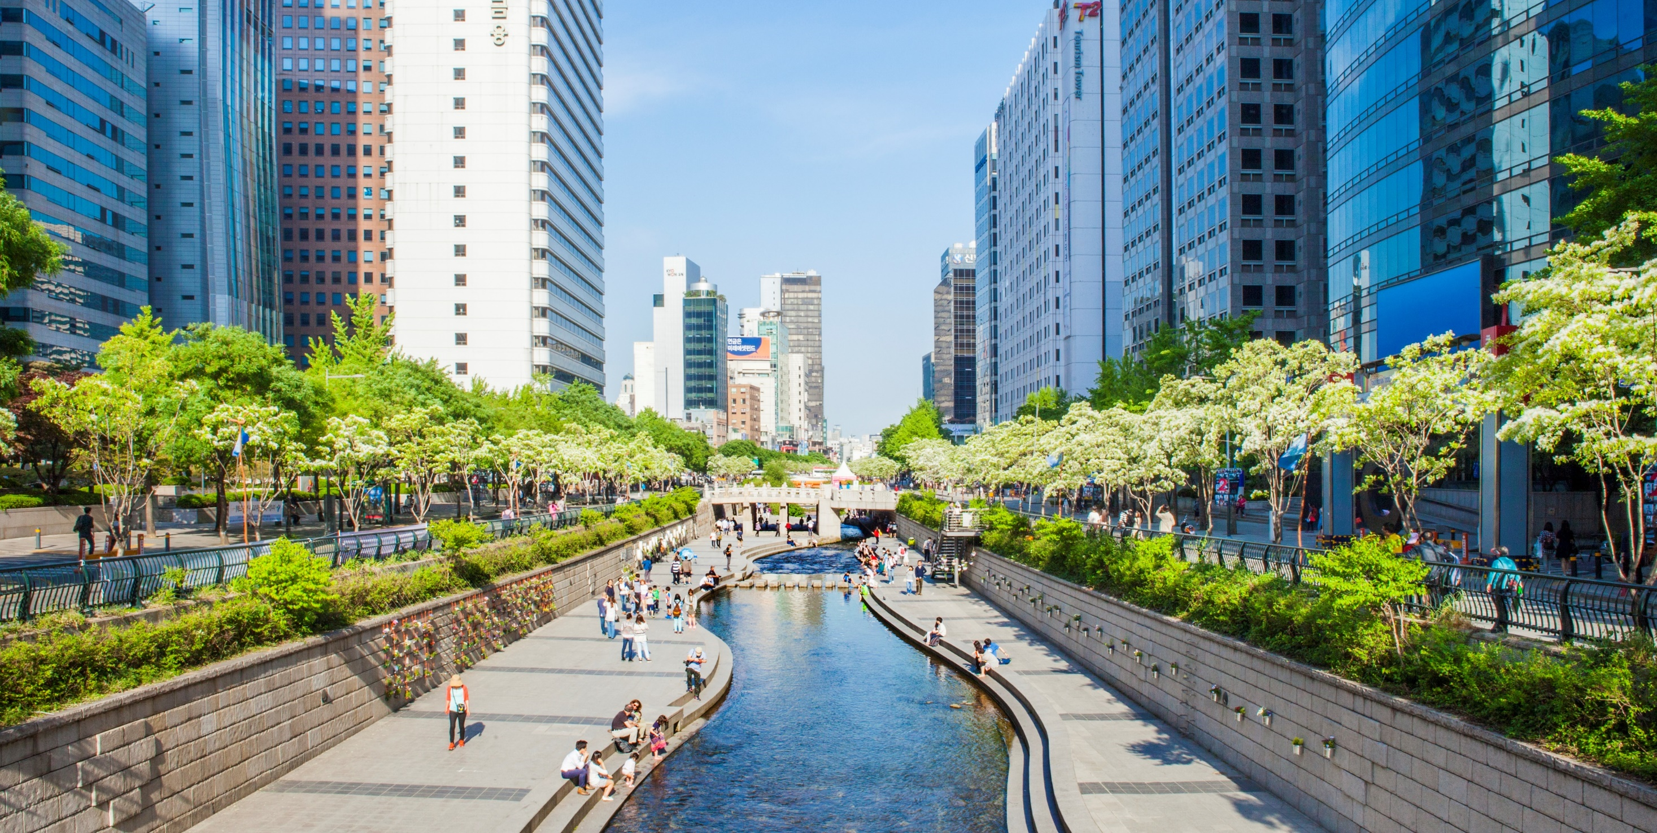
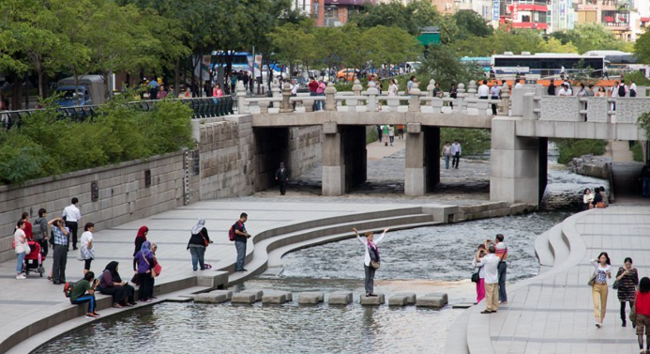
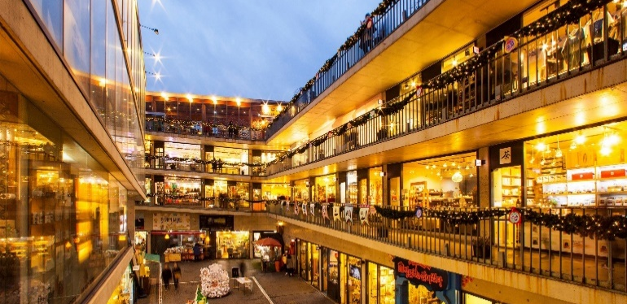
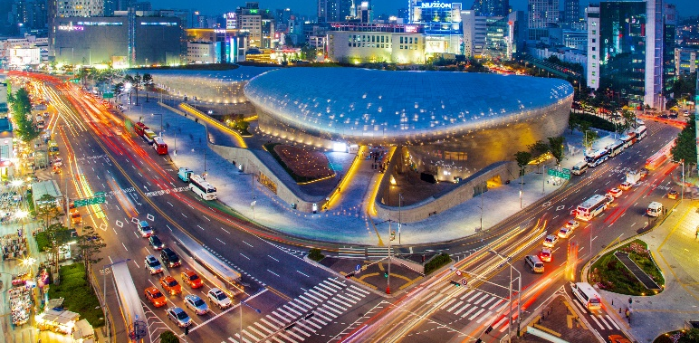
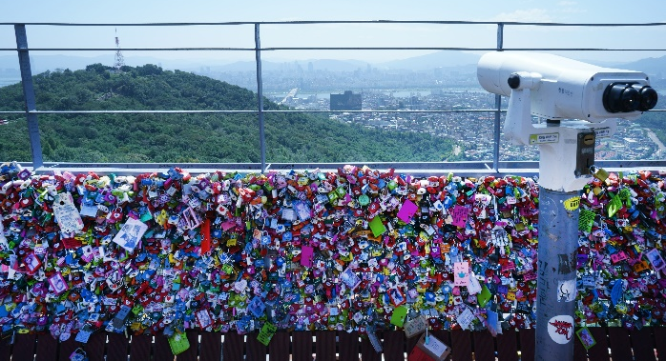
Seoul Downtown
Gwangtonggyo(Br.)
Insa-dong
Dongdaemun Design Plaza
N-Tower
Cheonggye Gwangjang(Sq.)

Slide 7
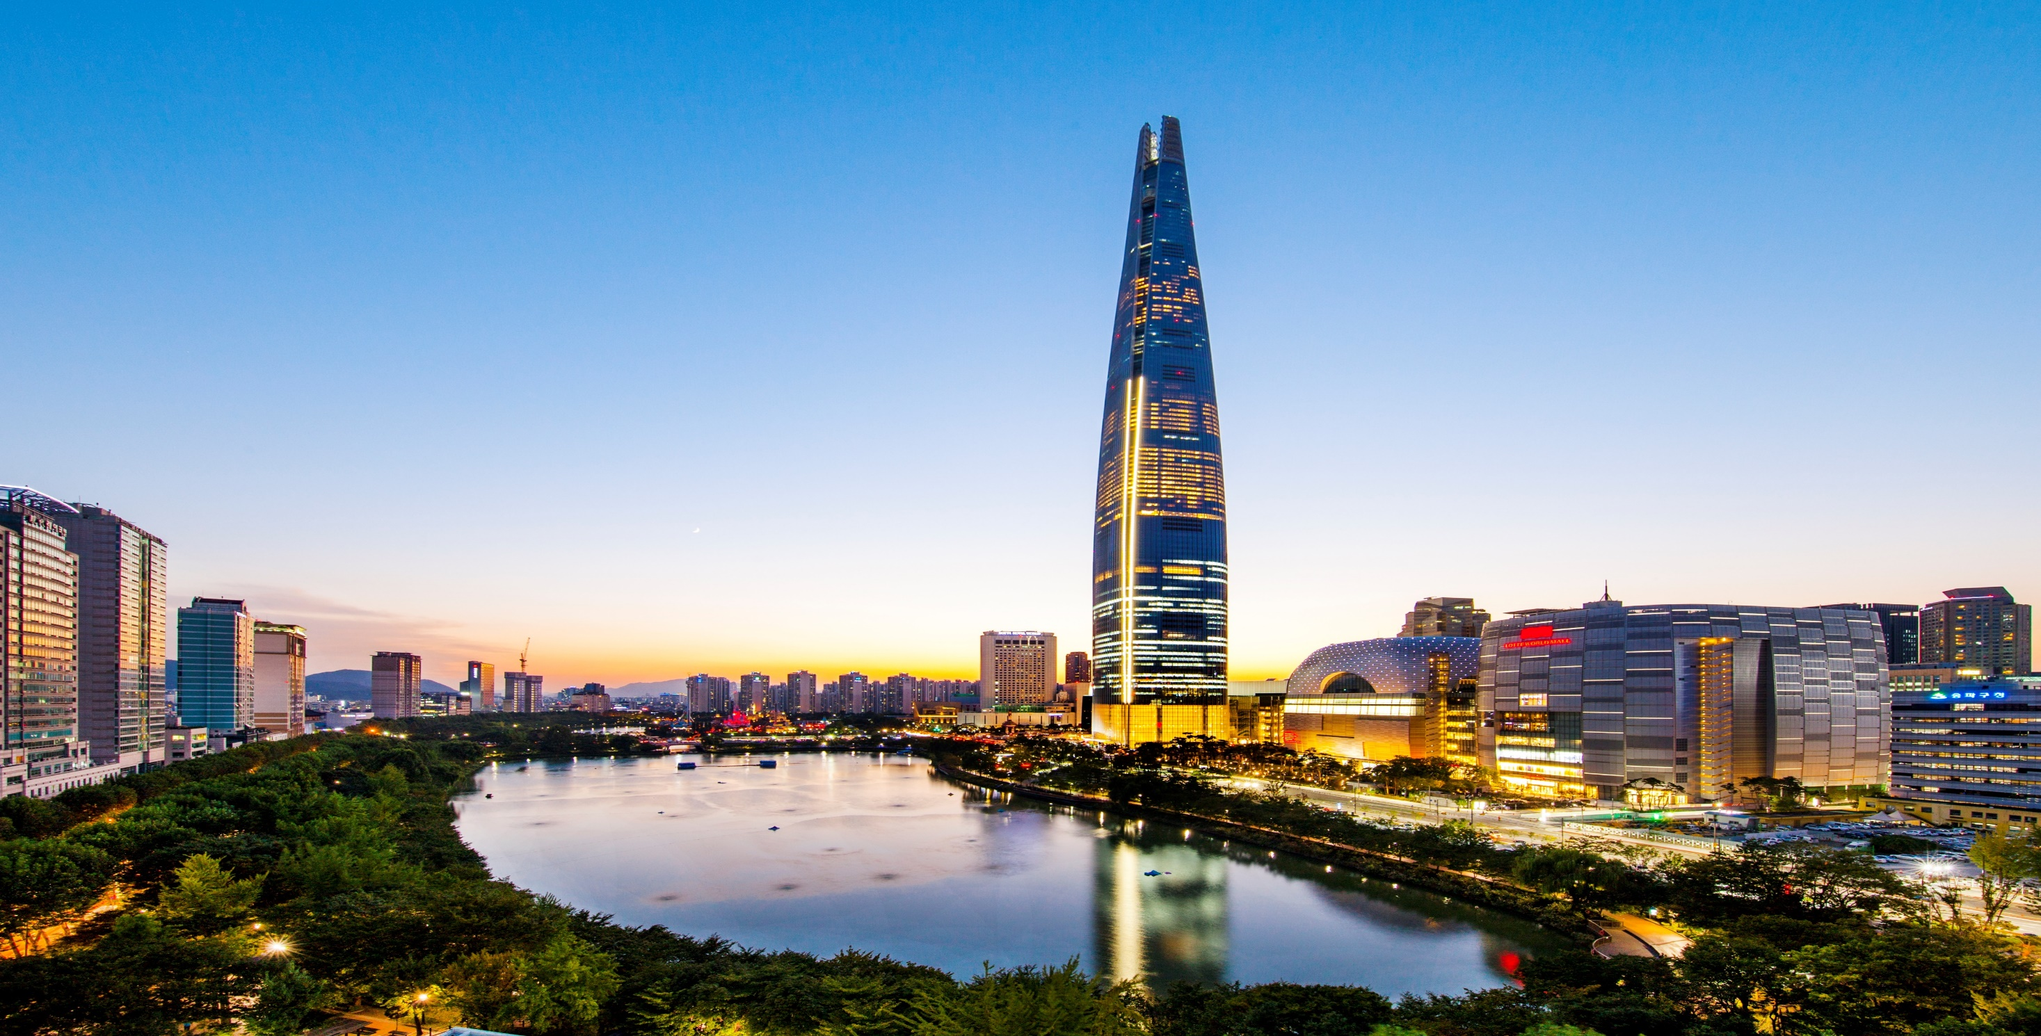
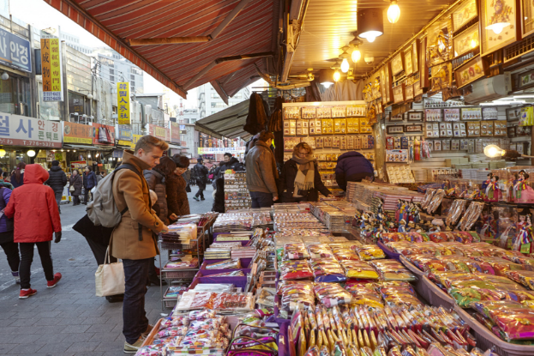
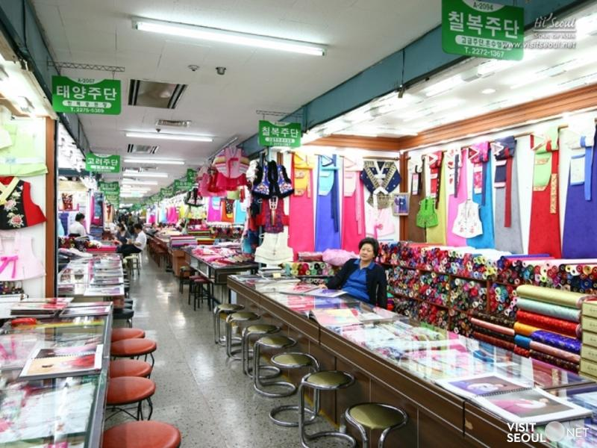
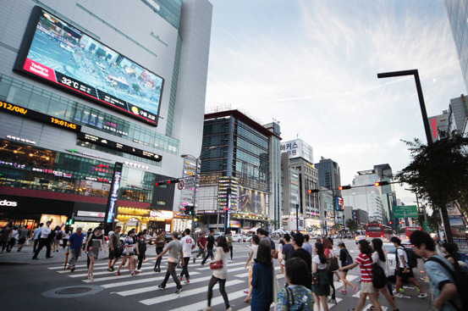
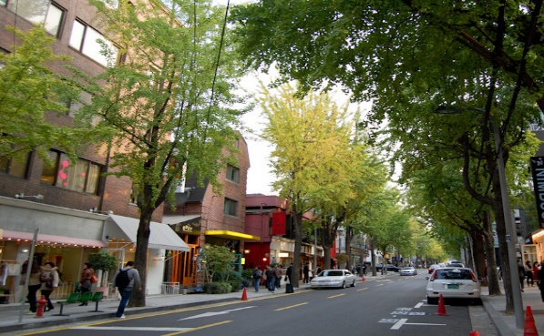
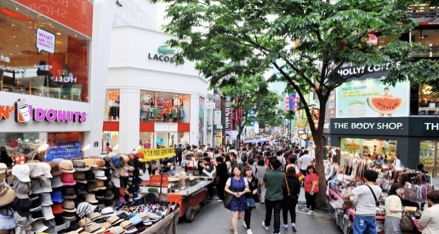
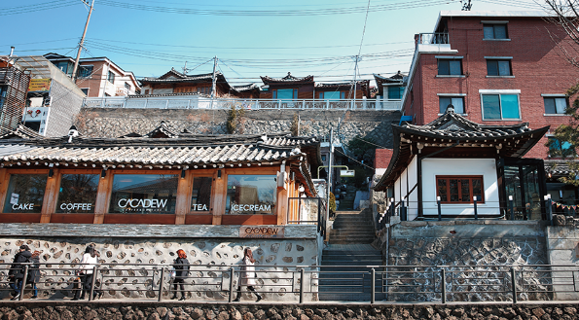
Seoul City
Namdaemun Market
Dongdaemun –
Pyeonghwa Market
Gangnam
Garosu-gil Café Street
Myeong-dong Shopping Street
Samcheong-dong Café Street
2nd Lotte World Mall Tower

Slide 8


SSBSE 2025, 16 Nov 2025
Hope to see you all in Seoul!
Notes:
So, we have little more than one year, around 15 months, from this moment to the next event.
Actually, together with ASE, this is first time major SE conference physically come to South Korea.
We had ICSE and ISSTA 2020 and 2021, but both were conducted fully online due to the pandemic issue.
SE community in Korea is waiting for hosting SE researchers from world-wide.
I will try my best to make SSBSE 2025 successful and enjoyable.
Hope to see you all in Seoul.

